Slide 1
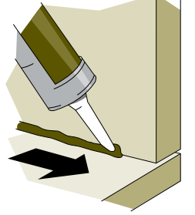
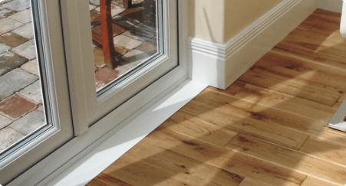
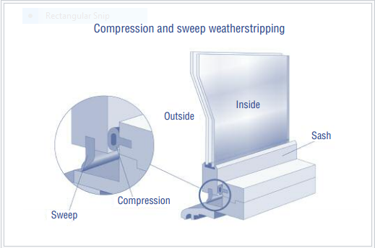
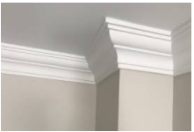
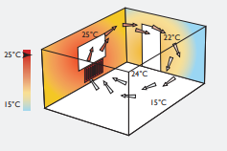
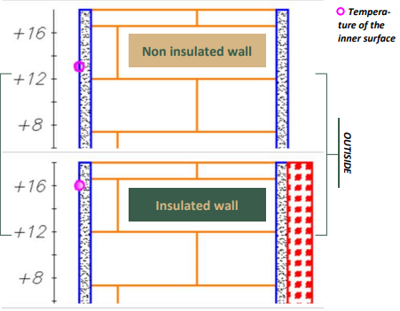
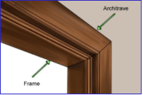
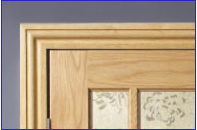
BUILDING REGULATION CODE ; J3.6 (a) Construction of ceilings, walls, and floors
Abstract
Building joints account for more than 30% of the temperature regulated in the building. The purpose of this poster is to offer clear presentation guidelines on how to design and construct energy-efficient houses. The guidelines follow the national construction Code (NCC), 2019, under the building codes of Australia (BCA). The designs are aimed to provide energy efficiency within the building through regulating energy flows in the building. It will demonstrate efficient sealing materials and methods to ensure an airtight house.
Skirting
The jointing where the wall merges the floor components plinth heating can effectively provide additional heat into the house. Fitting the skirting to the plinth creates a warm and comfortable and inhibits entry of dust and moisture into the house. It also prevents the loss of heat from the building to the adjacent components
Windows, door frames, and roof lights caulking
Caulk is a flexible material that will seal the air leaks through the cracks, gaps, and joints less than a quarter-inch between the stationary building components. The materials are applied to moving elements such as the operable windows and doors (Savings Project 2019). When the doors and the windows are appropriately sealed, the heat and cold remain inside during the winter and the summer climates. Inadequate sealing of the joints leads to the entry of drafts, making it hard for the heating and cooling systems to regulate temperatures. Caulking the joints lowers the overall cost of regulating energy in houses and reduces the repairs and replacements of the building envelopes.
Clause explanation
Design and construction of ceilings, walls, floors, and any other openings such as the window frames, door frames, and roof light flames must be installed and constructed airtight to minimize the linkage according to the NCC BCA 2019 clause J3.6 (a). The construction of these building components at mediums that connects the internal building with the external buildings or in the climatic zones are to be enclosed by an internal lining system at each junction. The junctions joining the walls to the floor area are sealed with skirting and grouting applied to seal, avoiding the element joint. The wall to the ceiling junctions must be sealed with cornice molding, and the jointing between the doors and window should be sealed with an architrave. Other materials such as the expanding foam must be applied on the interiorly of the wall to regulate the house temperatures. The opening joints between the stationary building and operable components can be sealed using caulk polymer, silicone, or Rubber Compressible stripping (BCA 2019).
conclusion
When all the joints in a building are adequately sealed, the air is kept trapped. Heat is kept inside the building in summer and winter weather. The heat radiation around the house remains constant and evenly distributed across the place. As the warm radiation rises, the cooler air will descend to replace the low pressures of the warm air, heats up, and the current continues.
Cornice
A cornice is a material molding that seals the gap between the roof sealing and the wall-building envelop to prevent air entry from the roof void. It also contains the loss of energy from the building to the outside through convection. Cornice materials vary from medium density fiberboard, paper covered plaster, expanded polystyrene, polyurethane, and gypsum. MRMDF boards are most effective as they can tolerate extreme heat or dam condition.
Rubber Compressible stripping
Compressible stripping is a low-cost method used inoperable windows and doors to provide better protection against air drafts. The polymer is used to seal doors or windows joints when the operable component is closed. They are designed to operate under compression or by sliding along the joints. Designers should ensure that the strips appropriately cover the gap, not allowing air to venture through them. When selecting which compressible stripping to use, consider the gap size to be sealed and the durability of the rubber (Weatherstripping.,2020). The compressible rubber stripping has an advantage over the other weather-stripping materials in that they are flexible and easy to operate on.
Thermal regulation
Architraves
Architraves are trims fitted around the door and window frames of internal doors. The mold is fitted to fill the gap between the frame and the rough opening. Sealing the space between the door frame and the wall component prevents entry of draft and air into the building envelop (BCA 2019). As the warm air from the floor rises, it may find its way through the gaps between the operable joints and the building adjacent building component.
References
Building code of Australia (BCA) & Australian standards. (2019). Housing Industry Association (HIA). https://hia.com.au/business-information/standards-regulations/building-standardss
Is expanding foam insulation right for your Home| External wall insulation. (2021, August 9). Evergreen Power UK. https://www.evergreenpoweruk.com/is-expanding-foam-insulation-right-for-your-home/
Savings Project: How to seal air leaks with caulk. (2019). Energy.gov. https://www.energy.gov/energysaver/services/do-it-yourself-energy-savings-projects/savings-project-how-seal-air-leaks-caulkk
Weather-stripping. (2020). Energy.gov. https://www.energy.gov/energysaver/weatherize/air-sealing-your-home/weatherstripping
What are cornices? (Styles, history, and uses of cornices). (2020, April 27). Australian Molding and Door Company. https://www.australianmoulding.com.au/what-are-cornices/
Expanding foam
Expanding foams are polymer products that are designed o expand and harden upon contact with the air. The foam will expand and seal the joint gaps, avoiding unnecessary moisture entering the building through the lining. This type of insulation will help regulate the heat since the warmer air is lighter. It will tend to rise, leaving the lower areas of the house cooler .Application of expanding foam in joints and interior wall surfaces to resist heat transfer and blocks unnecessary air infiltration through the gaps (External wall insulation, 2021). Trapping the heat makes the house warmer, unlike installing heat insulators where heat will escape through the joints.

